Slide 1

CHURN PREVENTION BLUEPRINT : A SYRIATEL CASE STUDY
From Data to Action: Reducing Attrition with Predictive Analytics

Slide 2
BUSINESS PROBLEM
SyriaTel, a leading telecom provider, faces rising customer churn in a highly competitive market. Retaining customers is critical for long-term growth and profitability. This project leverages data and machine learning to better understand churn patterns and guide proactive retention strategies.
PROJECT OBJECTIVES
Which customer behaviors and service patterns are most predictive of churn?
Can we identify specific customer segments that are more likely to leave?
What proactive actions can the business take to reduce churn based on these insights?

Slide 3
DATA UNDERSTANDING
Dataset Summary
The dataset contains 3,333 customer records and 21 features. There are no missing values or duplicate entries, indicating that the data is clean. The features include a mix of categorical, numerical, and boolean variables. The target variable is churn, which is a binary outcome indicating whether a customer has churned (True) or not (False).
Observations
The dataset includes a healthy mix of feature types suitable for machine learning.
No preprocessing is needed for missing values or duplicates.
The target variable (`churn`) is imbalanced only 14.5% of customers churned.
Why Class Imbalance Matters
A model may achieve high accuracy by predicting most customers as “not churned”.
We'll focus on Precision, Recall, F1-Score, and ROC-AUC for evaluation.

Slide 4

DATA CLEANING & PREPARATION
Before modeling, we applied several key steps to prepare the data for analysis:
Dropped Uninformative Columns:
phone number: a unique identifier with no predictive value.
state: high cardinality leading to model complexity and potential overfitting.
area_code: low correlation with churn and limited behavioral insight.
Categorical Encoding:
Converted international plan and voice mail plan from 'yes'/'no' to 1/0.
Target Variable Transformation:
Encoded churn (True/False) to 1/0 using LabelEncoder.
Column Name Standardization:
Lowercased all names.
Trimmed whitespaces.
Replaced spaces with underscores.
Final Dataset:
3,333 rows, 20 features.
No missing or duplicate values.

Slide 5
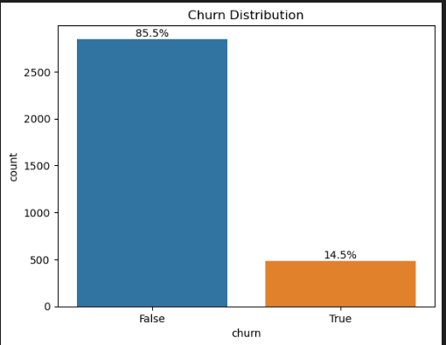
EXPLORATORY DATA ANALYSIS
Target Variable Distribution
Bar plot showing churn distribution with percentages (85.5% not churned, 14.5% churned)
Key Points:
Significant class imbalance: 14.5% of customers have churned.
Imbalance necessitates resampling techniques during model training to avoid model bias.

Slide 6
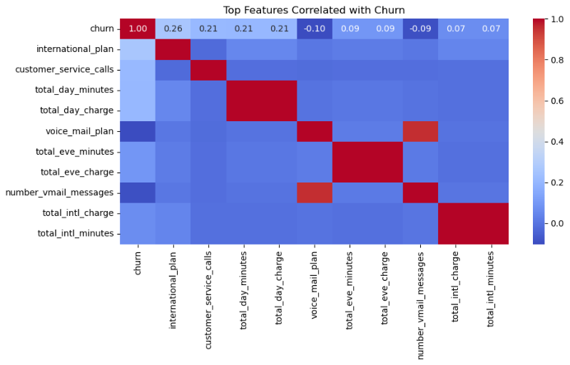
CORRELATION BETWEEN FEATURES AND CHURN
We looked at how different features relate to churn:
Higher Churn Risk
International Plan (+0.26): Customers with this plan churn more.
Customer Service Calls (+0.21): More calls mean higher churn.
Day Usage (+0.21): Heavy daytime use is linked to churn.
Mild Positive Links
Evening, night, and international usage show weak links to churn.
Lower Churn Risk
Voice Mail Plan (-0.10): These customers churn less.
Voicemail Messages (-0.09): More messages, lower churn.
International Calls (-0.05): More calls, slightly less churn.

Slide 7
CUSTOMER BEHAVIOR INSIGHTS (UNIVARIATE & BIVARIATE ANALYSIS)
Key Usage Patterns (Univariate)
Most features show balanced (normal) distributions.
Voicemail usage is low many users have zero messages.
International and customer service calls are right-skewed , most users make few, but some make many.
Area codes cluster into two main groups.
Churn vs. Behavior (Bivariate)
International Plan → Higher churn
Voice Mail Plan → Lower churn
More customer service calls → More churn
More voicemail messages → Less churn
Usage & Charges
Churners tend to have higher usage (day, evening, night, international) and higher charges.
Call counts don’t differ much, but charges do — usage intensity matters.
Account length is slightly shorter for churners, but not a strong factor.
Regional Insights (State-level)
States like New Jersey, California, and Texas show above-average churn rates.
Geography may influence churn due to competition, infrastructure, or regional preferences.
These insights help in targeted business strategy, even if state is dropped in modeling.

Slide 8
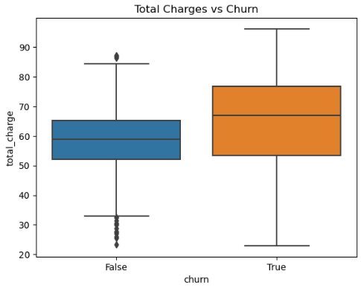
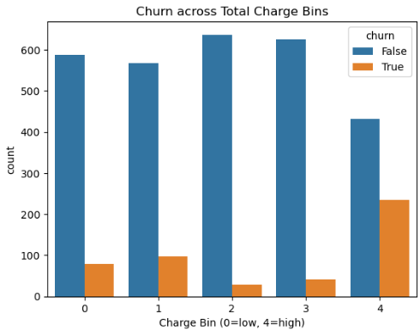
RELATIONSHIP BETWEEN TOTAL CHARGES AND CUSTOMER CHURN
Total Charges vs. Churn
Customers who churned had higher total charges on average.
Those who stayed tended to spend less overall.
This suggests high spenders may be less satisfied.
Binned Charges Analysis
We grouped customers into 5 spending levels based on their total charges:
Middle spenders (Bin 2) had the lowest churn — they may be more content.
Highest spenders (Bin 4) had the highest churn rate — possible signs of dissatisfaction.
Other groups (Bins 0, 1, 3) showed mixed churn patterns.
What This Tells Us:
The link between spending and churn isn’t simple.
More spending ≠ more loyalty.
Mid-level spenders are the most loyal group.

Slide 9
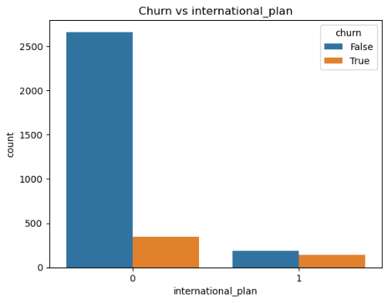
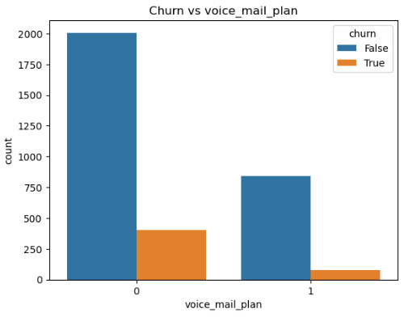
CHURN BY SUBSCRIPTION PLAN
We looked at how churn differs for two customer plans:
International Plan
Customers with an international plan churn more often than those without.
This may point to lower satisfaction among international plan users.
Voice Mail Plan
Customers with a voice mail plan churn less than those without.
This could mean that value-added services help improve retention.

Slide 10
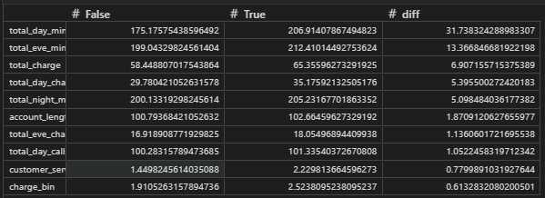
WHAT SETS CHURNED CUSTOMERS APART?
Talk Time:
Customers who left used more daytime minutes. This might point to frustration with costs or value.
Higher Charges:
Those who churned had larger phone bills. Spending more might have led to dissatisfaction.
More Customer Service Calls:
They reached out for help more often, which could mean they were facing unresolved issues.
Time with the Company:
People who stayed had slightly longer relationships and made more regular calls.

Slide 11
DATA PREPARATION FOR MODELING
Before building our churn prediction model, we refined the dataset to improve accuracy and prevent technical issues:
Final Data Cleanup
Dropped non-informative features:
phone_number (just an ID)
state, area_code (low or misleading predictive value)
Standardized data:
Encoded international_plan and voice_mail_plan as 1/0
Encoded target churn as 1/0
Cleaned column names for consistency
Addressing Multicollinearity
To avoid model confusion from overlapping data, we removed highly correlated features using VIF (Variance Inflation Factor):
Dropped 7 Features:
Charges like total_day_charge, total_charge etc were redundant with minute values hence we dropped them
number_vmail_messages overlaps heavily with voice_mail_plan hence dropped as well
charge_bin — derived from total_charge, adds no new value hence had to be dropped
Remaining 13 features are clean, independent, and ready for modeling.
Balanced the Target Variable
Original churn rate: ~14.5%
After using SMOTE, churn vs. no-churn is now 50/50 in the training set.
This helps the model treat both outcomes fairly during training.

Slide 12
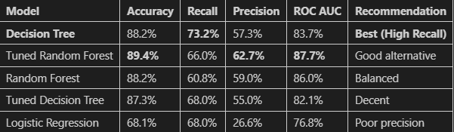
MODELLING
We explored different models to predict which customers are likely to churn.
Three main approaches were tested:
Logistic Regression – A statistical method for classification.
Decision Tree Classifier – A model that learns decision paths like a flowchart.
Random Forest Classifier – Ensemble method for improved accuracy and robustness.
We chose Decision Trees because they gave the best performance while being easy to explain and visualize.

Slide 13
OUR FINAL MODEL: DECISION TREE
Threshold Tuning Insight
By adjusting our prediction threshold to 42.1%, we identified 3% more churners while only slightly increasing false alerts.
Metric | Score | Intepretation
Recall | 73.2% | Catches about 7 out of 10 churners
Precision | 57.3% | Around 4 in 10 alerts are false alarms
ROC-AUC | 83.7% | Strong separation between churners and loyal customers

Slide 14
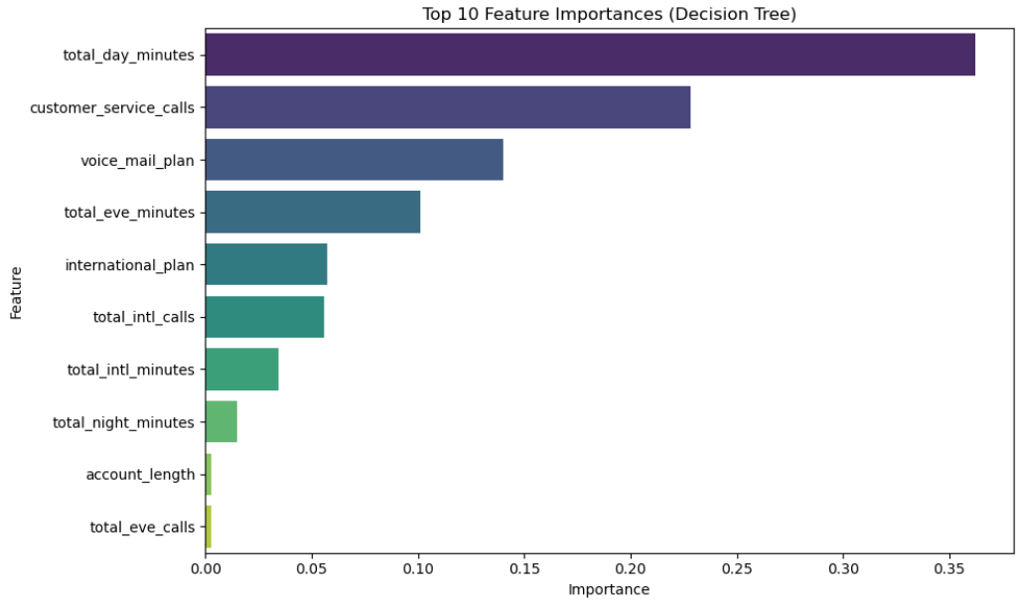
FEATURE IMPORTANCE
What Actually Predicts Churn?
Our Decision Tree model ranked features by importance. Top contributors included:
Total day minutes (36.2%)
Customer service calls (22.8%)
Voicemail plan (14.0%)
Evening minutes (10.1%)
International plan (5.8%)

Slide 15
Business Impact of Our Churn Model
Understanding how churn predictions affect revenue
Model Accuracy Highlight:
Recall Rate: 75.3%
We’re catching 3 out of 4 actual churners, helping retain valuable customers.
Metric | Value | Intepretation
Annual Revenue at Risk | $59,243.04 | Money at stake if actual churners are identified—this is the "win zone".
False Positive Costs | $2,650.00 | Wasted cost on customers wrongly flagged as churners—"false alarm zone".
Missed Churn Revenue | $19,056.84 | Revenue lost from churners we didn’t catch—"missed opportunity zone".

Slide 16
RECOMMENDATIONS
Promote International Plans: Target customers without international calling offer bundled discounts to boost retention.
Proactive Support for Frequent Callers: High support interactions signal dissatisfaction assign dedicated reps or early surveys to prevent churn.
Personalized Incentives for Heavy Users: Reward frequent callers with bonus minutes, loyalty perks, or discounted rates.
Automate High-Risk Alerts: Integrate churn predictions into CRM for real-time SMS offers or exclusive deals.
Act Fast on High-Risk Customers: Immediate loyalty offers or premium support can prevent escalation.
Regional & Onboarding Focus: Strengthen retention in high-churn states such as New Jersey, California and Texas with localized campaigns and better onboarding.
Tiered Discounts for High Spenders: Offer tailored discounts to high-bill users and incentivize newer customers early.

Slide 17
LIMITATIONS
SMOTE may cause overfitting, affecting real-world performance.
Model scope was limited to three algorithms without deeper tuning.
Some churn patterns lack context, needing more customer behavior data.
Geographic churn trends weren’t deeply explored, missing regional insights.
Call data lacked quality indicators, limiting support-related analysis.
NEXT STEPS
Experiment with advanced models like XGBoost and LightGBM.
Run A/B tests on targeted retention campaigns

Slide 18

THANK YOU
For any inquiries, please contact me at:
akinyimarilyn@gmail.com
UserName: Marilyn Akinyi

